Slide 1

BALA template #10
CS 473 – MDP
Mobile Device Programming
© 2020 Maharishi International University
All course materials are copyright protected by international copyright laws and remain the property of the Maharishi International University. The materials are accessible only for the personal use of students enrolled in this course and only for the duration of the course. Any copying and distributing are not allowed and subject to legal action.
Maharishi International
University

Slide 2
BALA template #10
CS 473 – MDP
Mobile Device Programming
MS.CS Program
Department of Computer Science
Renuka Mohanraj, Ph.D.,
Maharishi International
University

Slide 3
BALA template #10
CS 473 – MDP
Mobile Device Programming
Lesson 4
Views, Layouts, Resources and Activity Life Cycle
Maharishi International
University

Slide 4
Wholeness
In this lecture we examine additional fundamental building blocks of Android apps including the layouts, input/output controls, and buttons. We also explore resources and activity life cycle. App can build effectively with this fundamental knowledge. The most fundamental knowledge is the most important knowledge, since everything else is built upon it. The reason TM can provide such a wide range of benefits to life in general is because it works at such a truly fundamental level.

Slide 5

Contents
Views, view groups, and view hierarchy
Layouts in XML and Kotlin code
Resources
Activity Life Cycle
Save State Information call backs
Hands on Examples – Basic UI, Simple Calculator, Working with ScrollView, Lifecycle Activity and Save state

Slide 6
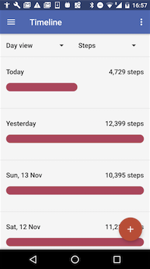
Everything you see is a view
If you look at your mobile device,
every user interface element that you see is a View.
Views

Slide 7
What is a view
Views are Android's basic user interface building blocks.
display text (TextView class), edit text (EditText class)
buttons (Button class), menus, other controls
scrollable (ScrollView, RecyclerView)
show images (ImageView)
subclass of View class

Slide 8
Views have properties
Have properties (e.g., color, dimensions, positioning)
May have focus (e.g., selected to receive user input)
May be interactive (respond to user clicks)
May be visible or not
Have relationships to other views

Slide 9
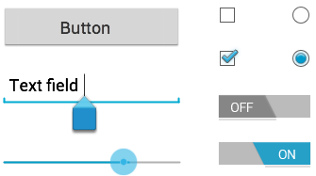
Examples of views
Button
EditText
SeekBar
CheckBox
RadioButton
Toggle

Slide 10
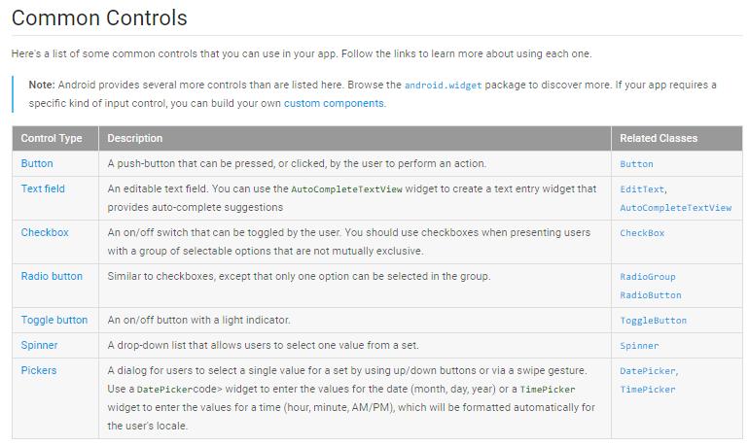
Refer for more Info : https://developer.android.com/guide/topics/ui/index.html

Slide 11
Creating and laying out views
Graphically using XML Design Editor
XML Code Editor
Programmatically

Slide 12
Views defined in XML
<TextView
android:id="@+id/show_count"
android:layout_width="match_parent"
android:layout_height="wrap_content"
android:background="@color/myBackgroundColor"
android:text="@string/count_initial_value"
android:textColor="@color/colorPrimary"
android:textSize="@dimen/count_text_size"
android:textStyle="bold"
/>

Slide 13
View properties in XML
android:<property_name>="<property_value>"
Example: android:layout_width="match_parent"
android:<property_name>="@<resource_type>/resource_id"
Example: android:text="@string/button_label_next"
android:<property_name>="@+id/view_id"
Example: android:id="@+id/show_count"

Slide 14
ViewGroup views
A ViewGroup (parent) is a type of view that can contain other views (children)
ViewGroup is the base class for layouts and view containers
ScrollView—scrollable view that contains one child view
LinearLayout—arrange views in horizontal/vertical row
RecyclerView—scrollable "list" of views or view groups

Slide 15
Hierarchy of view groups and views
ViewGroup
Root view is always a view group
ViewGroup
View
View
View
View
View

Slide 16
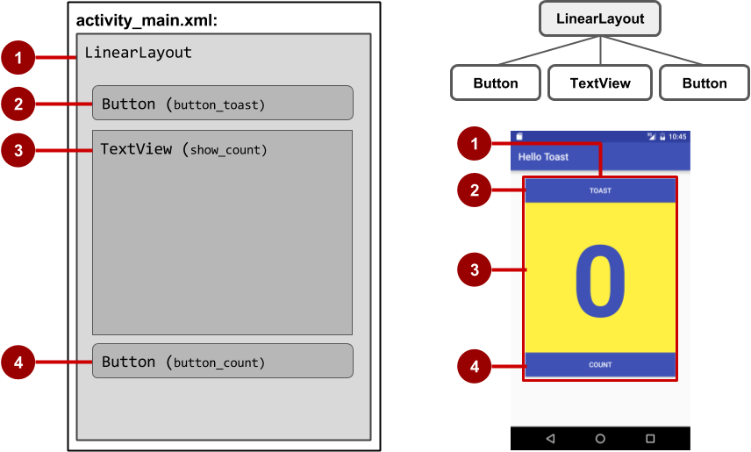
View hierarchy and screen layout

Slide 17
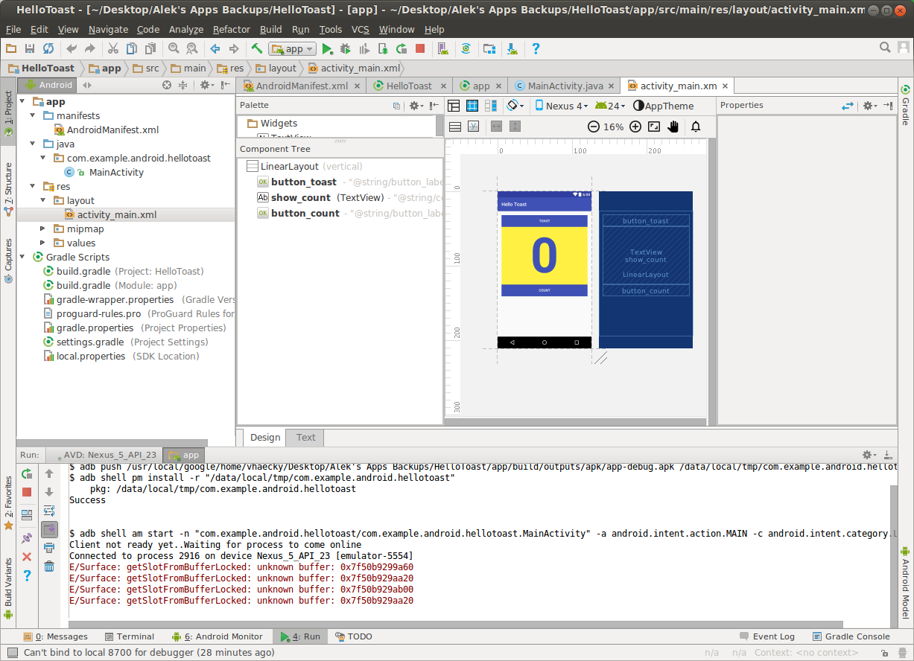
View hierarchy in the component tree

Slide 18
Best practices for view hierarchies
Arrangement of view hierarchy affects app performance
Use smallest number of simplest views possible
Keep the hierarchy flat—limit nesting of views and view groups

Slide 19
Layout Views
Layouts
are specific types of view groups
are subclasses of ViewGroup
contain child views
can be in a row, column, grid, table, absolute

Slide 20




Common Layout Classes
LinearLayout
RelativeLayout
GridLayout
TableLayout

Slide 21
Common Layout Classes
LinearLayout - horizontal or vertical row
RelativeLayout - child views relative to each other
TableLayout - rows and columns
ConstraintLayout - connect views with constraints
FrameLayout - shows one child of a stack of children
GridView - 2D scrollable grid
In our course we are going to discuss the first three layouts.

Slide 22
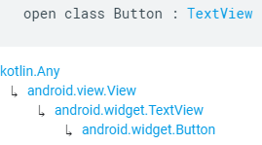
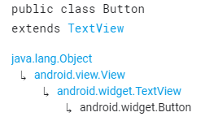
Class Hierarchy vs. Layout Hierarchy
View class-hierarchy is standard object-oriented class inheritance
For example, Button is-a TextView is-a View is-a Object
Superclass-subclass relationship
Kotlin class-hierarchy Java class-hierarchy
Layout hierarchy is how Views are visually arranged
For example, LinearLayout can contain Buttons arranged in a row
Parent-child relationship

Slide 23
Layout created in XML
<LinearLayout
android:orientation="vertical"
android:layout_width="match_parent"
android:layout_height="match_parent">
<EditText
... />
<Button
... />
</LinearLayout

Slide 24
Layout created in Kotlin Activity code
val linearL = LinearLayout(this)
linearL.setOrientation(LinearLayout.VERTICAL)
val myText = TextView(this)
myText.setText("Display this text!")
linearL.addView(myText)
setContentView(linearL)

Slide 25
Main Point 1
Views are the basic building block for user interface components. Layouts are used to organize Views. Science of Consciousness: : In a similar way, creation itself is structured in layers; the activity at each layer has its own unique set of governing laws; laws that pertain to one level or layer may longer be applicable at another level.

Slide 26
Linear Layout Example
<LinearLayout xmlns:android= "http://schemas.android.com/apk/res/android"
android:layout_width="match_parent"
android:layout_height="match_parent"
android:orientation="vertical">
<TextView
android:id="@+id/TextView01"
android:text="Text View"
android:layout_height="wrap_content"
android:layout_width="match_parent" />
<Button
android:id="@+id/Button01"
android:layout_width="match_parent"
android:layout_height="wrap_content"
android:text="Press Me" />
</LinearLayout>
Here’s an XML layout resource example of a LinearLayout set to the size of the screen, containing one TextView that is set to its height and the width of the LinearLayout.
android:id="@+id/Button01"
If you want to access the component from xml to Kotlin code, you must configure the id for the component using the above line of code

Slide 27
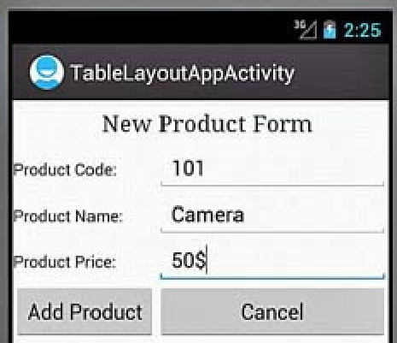
Hands on Example 1 - Table Layout
<TableLayout xmlns:android="http://schemas.android.com/apk/res/android"
android:orientation="vertical"
android:layout_width="match_parent"
android:layout_height="match_parent"
android:stretchColumns="1">
<TableRow android:padding="5dip">
<TextView
android:layout_height="wrap_content"
android:text="New Product Form"
android:typeface="serif"
android:layout_span="2"
android:gravity="center_horizontal"
android:textSize="20sp" />
</TableRow>
Notes:
Stretching Columns
The default width of a column is set equal to the width of the widest column, but we can stretch the column(s) to take up available free space using the android:stretchColumns attribute in the TableLayout. The value assigned to this attribute can be a single column number or a comma-delimited list of column numbers. The specified columns are stretched to take up any available space on the row.
android:stretchColumns="1"—The second column (because the column numbers are 0-based) is stretched to take up any available space in the row.
android:stretchColumns="0,1"—Both the first and second columns are stretched to take up the available space in the row.
android:stretchColumns="*"—All columns are stretched to take up the available space.
Spanning Columns
We can make a column span or take up the space of one or more columns by using the android:layout_span attribute. The value assigned to this attribute must be >=1. For example, the following value makes the control take or span up to two columns:
android:layout_span="2"

Slide 28
Hands on Example 1 - Table Layout
<TableRow>
<TextView
android:layout_height="wrap_content"
android:text="Product Code:"/>
<EditText
android:id="@+id/prod_code"
android:layout_height="wrap_content"/>
</TableRow>
<TableRow>
<TextView
android:layout_height="wrap_content"
android:text="Product Name:" />
<EditText
android:id="@+id/prod_name"
android:layout_height="wrap_content"/>
</TableRow>
<TableRow>
<TextView
android:layout_height="wrap_content"
android:text="Product Price:" />
<EditText
android:id="@+id/prod_price"
android:layout_height="wrap_content" />
</TableRow>
<TableRow>
<Button
android:id="@+id/add_button"
android:text="Add Product"
android:layout_height="wrap_content" />
<Button
android:id="@+id/cancel_button"
android:text="Cancel"
android:layout_height="wrap_content" />
</TableRow>
</TableLayout>
Notes:
Stretching Columns
The default width of a column is set equal to the width of the widest column, but we can stretch the column(s) to take up available free space using the android:stretchColumns attribute in the TableLayout. The value assigned to this attribute can be a single column number or a comma-delimited list of column numbers. The specified columns are stretched to take up any available space on the row.
android:stretchColumns="1"—The second column (because the column numbers are 0-based) is stretched to take up any available space in the row.
android:stretchColumns="0,1"—Both the first and second columns are stretched to take up the available space in the row.
android:stretchColumns="*"—All columns are stretched to take up the available space.
Spanning Columns
We can make a column span or take up the space of one or more columns by using the android:layout_span attribute. The value assigned to this attribute must be >=1. For example, the following value makes the control take or span up to two columns:
android:layout_span="2"

Slide 29
MainActivity.kt
import androidx.appcompat.app.AppCompatActivity
import android.os.Bundle
import android.widget.Button
import android.widget.Toast
class MainActivity : AppCompatActivity() {
override fun onCreate(savedInstanceState: Bundle?) {
super.onCreate(savedInstanceState)
setContentView(R.layout.activity_main)
val badd = findViewById<Button>(R.id.add_button)
val bcan = findViewById<Button>(R.id.cancel_button)
// Anonymous Implementation of Button click event listener to give a toast Message
badd.setOnClickListener {
Toast.makeText(this, "Add Product Button Pressed", Toast.LENGTH_LONG).show()
}
bcan.setOnClickListener {
Toast.makeText(this, "Cancel Button Pressed", Toast.LENGTH_LONG).show()
}
}
} Refer Demo Code: Lesson4\TableLayoutApp

Slide 30

Relative Layout
The RelativeLayout view enables you to specify where the child View controls are in relation to each other.
For instance, you can set a child View to be positioned “above” or “below” or “to the left of” or “to the right of” another View.
You can also align child View controls relative to one another or the parent layout edges.
Combining RelativeLayout attributes can simplify the creation of interesting user interfaces without resorting to multiple layout groups to achieve a desired effect.

Slide 31
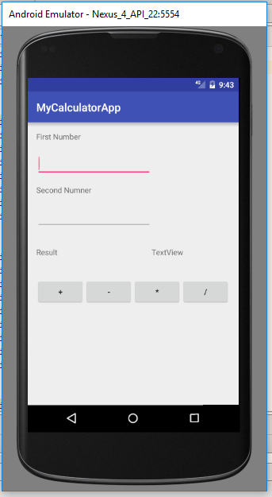
Hands on Example 2 – Simple Calculator using Relative and Linear Layouts
The requirement of this problem is to design a screen as per the screen shot, using nested layouts and performing click action on the operator buttons to display the Result. This screen uses 4 TextView, 2 EditText and 4 Buttons. The toper layout is Relative Layout and all buttons are combined using Linear Layout.
Refer Demo Code: Lesson4\CalculatorApp

Slide 32
XML Design(activity_main.xml
<TextView android:text="Second Numner" android:layout_width="wrap_content" android:layout_height="wrap_content" android:layout_marginTop="15dp" android:id="@+id/tv2" android:layout_below="@+id/et1" android:layout_alignLeft="@+id/et1" android:layout_alignStart="@+id/et1" /> <EditText android:layout_width="wrap_content" android:layout_height="wrap_content" android:inputType="number" android:ems="10" android:layout_marginTop="16dp" android:id="@+id/et2" android:layout_below="@+id/tv2" android:layout_alignParentLeft="true" android:layout_alignParentStart="true" /> <TextView android:text="Result" android:layout_width="wrap_content" android:layout_height="wrap_content" android:layout_marginTop="32dp" android:id="@+id/tv3" android:layout_below="@+id/et2" android:layout_alignParentLeft="true" android:layout_alignParentStart="true" /> <TextView android:text="TextView" android:layout_width="wrap_content" android:layout_height="wrap_content" android:id="@+id/tv4" android:layout_alignBaseline="@+id/tv3" android:layout_alignBottom="@+id/tv3" android:layout_toRightOf="@+id/et2" android:layout_toEndOf="@+id/et2" />
<RelativeLayout xmlns:android="http://schemas.android.com/apk/res/android" android:id="@+id/activity_main" android:layout_width="match_parent" android:layout_height="match_parent" android:paddingBottom="@dimen/activity_vertical_margin" android:paddingLeft="@dimen/activity_horizontal_margin" android:paddingRight="@dimen/activity_horizontal_margin" android:paddingTop="@dimen/activity_vertical_margin"> <TextView android:text="First Number" android:layout_width="wrap_content" android:layout_height="wrap_content" android:id="@+id/tv1" android:layout_alignLeft="@+id/et1" android:layout_alignStart="@+id/et1" android:layout_alignParentTop="true" /> <EditText android:layout_width="wrap_content" android:layout_height="wrap_content" android:inputType="number" android:ems="10" android:layout_marginTop="17dp" android:id="@+id/et1" android:layout_below="@+id/tv1" android:layout_alignLeft="@+id/et2" android:layout_alignStart="@+id/et2" />
Notes:
ems stands for Element size like font size

Slide 33
<LinearLayout android:orientation="horizontal" android:layout_width="match_parent" android:layout_height="wrap_content" android:layout_marginTop="38dp" android:layout_below="@+id/tv3" android:layout_alignParentLeft="true" android:layout_alignParentStart="true"> <Button android:text="+“
android:layout_width="wrap_content" android:layout_height="wrap_content" android:id="@+id/add“
android:onClick="click"/> <Button android:text="-" android:layout_width="wrap_content" android:layout_height="wrap_content" android:id="@+id/sub"
android:onClick="click"/>
<Button
android:text="*" android:layout_width="wrap_content" android:layout_height="wrap_content" android:id="@+id/mul“
android:onClick="click"/>
<Button android:text="/" android:layout_width="wrap_content" android:layout_height="wrap_content“
android:id="@+id/div“
android:onClick="click"/> </LinearLayout> </RelativeLayout>

Slide 34
Main Activity.kt
import androidx.appcompat.app.AppCompatActivity import android.os.Bundle import android.view.View; // To get the ids directly from XML without using findViewById() need to do below import import kotlinx.android.synthetic.main.activity_main.* class MainActivity : AppCompatActivity() { override fun onCreate(savedInstanceState: Bundle?) { super.onCreate(savedInstanceState) setContentView(R.layout.activity_main) }

Slide 35
Main Activity.kt
// click event implementation from xml android:onClick="click" fun click(view:View) { val num1 = et1.text.toString() // to retrieve a text like getter – 1st Input val num2 = et1.text.toString() // 2nd Input when (view.getId()) { // Read the clicked component R.id.add -> { val addition = Integer.parseInt(num1) + Integer.parseInt(num2) tv4.text = addition.toString() // Setting value to the text view like setter } R.id.sub -> { val minus = Integer.parseInt(num1) - Integer.parseInt(num2) tv4.text = minus.toString() } R.id.mul -> { val mult = Integer.parseInt(num1) * Integer.parseInt(num2) tv4. text = mult.toString() }
R.id.div -> try{ val dvd = Integer.parseInt(num1) /
Integer.parseInt(num2) tv4.text = dvd.toString() } catch (e:Exception) { tv4.text = "Division be Zero" } } } }

Slide 36
Resources
Separate static data from code in your layouts.
Strings, dimensions, images, menus, colors, styles
Useful for localization
Notes:
Dimens.xml → They’re intended to be used for styling dimensions (hence the name) such as width, height, etc.

Slide 37
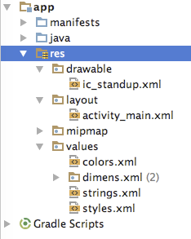
Where are the resources in your project?
resources and resource files
stored in res folder

Slide 38
Hands on Example 3 TextView, ScrollView & Resourses
TextView is a view for displaying single and multi-line text
EditText is a subclass of TextView with editable text
Controlled with layout attributes
Set text statically from a string resource in XML, or dynamically from Kotlin code and any source
The user may need to scroll.
News stories, articles, ...
To allow users to scroll a TextView, embed it in a ScrollView.
Other Views can be embedded in a ScrollView.
LinearLayout, TextView, Button, ...
ScrollView is a subclass of FrameLayout
Can only hold one view
Do not nest multiple scrolling views
Use HorizontalScrollView for horizontal scrolling
Use a RecyclerView for lists(Will discuss later)

Slide 39
Common TextView attributes
android:text—text to display
android:textColor—color of text
android:textAppearance—predefined style or theme
android:textSize—text size in sp
android:textStyle—normal, bold, italic, or bold|italic
android:typeface—normal, sans, serif, or monospace
android:lineSpacingExtra—extra space between lines in sp

Slide 40
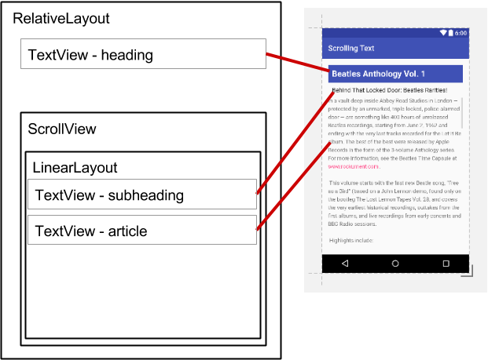
ScrollView layout with a view group
<ScrollView ...
<LinearLayout
android:layout_width="match_parent"
android:layout_height="wrap_content"
android:orientation="vertical">
<TextView
android:id="@+id/article_subheading" .../>
<TextView
android:id="@+id/article" ... />
</LinearLayout>
</ScrollView>

Slide 41
Main Point 2
Different layouts in Android helps to place and arrange the UI components and other layouts. These self-referral dynamics support a much broader range of possibilities in the design of UIs.

Slide 42
Activity Life Cycle
The activity base class defines a series of events that govern the life cycle of an activity. The set of states an activity can be in during its lifetime, from when it is created until it is destroyed.
Activity states and app visibility
Created (not visible yet)
Started (visible)
Resume (visible)
Paused(partially invisible)
Stopped (hidden)
Destroyed (gone from memory)
State changes are triggered by user action, configuration changes such as device rotation, or system action like changing language settings.

Slide 43
Callbacks and when they are called
Only onCreate() is required, Override the other callbacks to change default behavior
onCreate(Bundle savedInstanceState)—member fields initialization
onStart()—when activity (screen) is becoming visible
onRestart()—called if activity was stopped (calls onStart())
onResume()—start to interact with user
onPause()—about to resume PREVIOUS activity
onStop()—no longer visible, but still exists and all state info preserved
onDestroy()—final call before Android system destroys activity
Notes:
onCreate() - member fields initialization, restore saved state and call setContentView().
onStart() – listener implementation, resource allocation
onPause() - you should pause or stop on-screen animations and videos that you resumed or started in onResume()
onStop() - you will unregister all listeners and release all resources that were allocated in onStart()

Slide 44
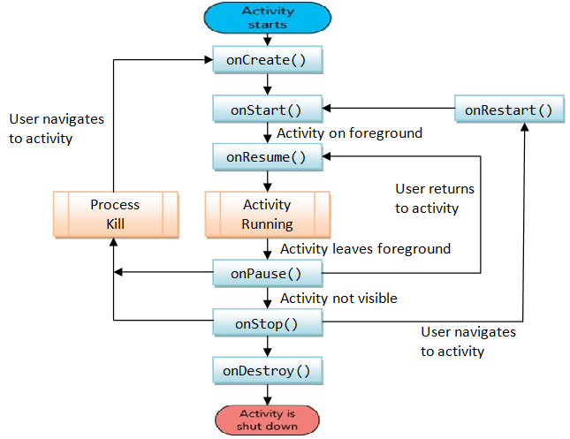
Activity Life Cycle

Slide 45
States of Activity Life cycle
1. Active State: [Activity in the Foreground/Running]
When an Activity is present at the top of the stack, it is the currently visible and focused Activity and all the user inputs are provided to it.
In order to keep this Activity active, Android provides it with all the required resources and also terminates the previous activities if required.
When another Activity becomes active, this Activity will be pushed to the paused state.

Slide 46
States of Activity Life cycle
2. Paused State:
An Activity in this state is visible, but another Activity will have the focus and is present in the foreground.
An Activity in the paused state is treated in the same way as it was treated when it was in the active state.
The only difference is that it will not receive any user input.
In serious cases, Android terminates a paused Activity to ensure availability of resources to the current Activity.
An Activity is stopped when it becomes totally obscure.

Slide 47
States of Activity Life cycle
3. Stopped State: [Activity in the background]
In this state, the Activity is not visible. It is however, present in the memory with all the state information.
All such activities are now ready for termination when the system requires memory.
When an Activity is stopped, it’s data and UI information needs to be saved.
An Activity becomes inactive when it is closed or exited.
4. Inactive State: [Activity Doesn’t exist]
When the Activity is no longer in the memory, it is said to be in the inactive state.
An Activity goes to the inactive state when it is terminated.
All such activities need to be restarted before they are used again.

Slide 48
Hands on Example 4: Life Cycle Activity
Now we are going to Override all these methods to know the activity life cycle and always call up to superclass when implementing these methods. The we are displaying the Log message using Log.i(String TAG,String msg) by import android.util.Log;
class MainActivity : AppCompatActivity() {
val MY_TAG = "lifecycle"
override fun onCreate(savedInstanceState: Bundle?) {
super.onCreate(savedInstanceState)
setContentView(R.layout.activity_main)
Log.i(MY_TAG,"Method in OnCreate");
}
Refer: Lesson4_LogCat Filter Steps.pdf file to learn how to create logcat from Sakai Lectures/Lesson4 folder

Slide 49
MainActivity.kt
override fun onStart() {
super.onStart()
Log.i(MY_TAG, "Method in OnStart")
}
override fun onResume() {
super.onResume()
Log.i(MY_TAG, "Method in OnResume")
}
override fun onPause() {
super.onPause()
Log.i(MY_TAG, "Method in OnPause")
}
override fun onStop() {
super.onStop()
Log.i(MY_TAG, "Method in OnStop")
}
override fun onRestart() {
super.onRestart()
Log.i(MY_TAG, "Method in OnRestart")
}
override fun onDestroy() {
super.onDestroy()
Log.i(MY_TAG, "Method in OnDestroy")
}
}
Notes:
Difference between Activity and AppcompatActivity
By using Activity class in android you will not have to include any library, but then you will also not be able to target devices with API level less then 11.
AppCompatActivity is good if you’re targeting devices below API level 11 too, it provides fragments and some of the latest functionality and helps if you want to deploy your application before API level 11.

Slide 50
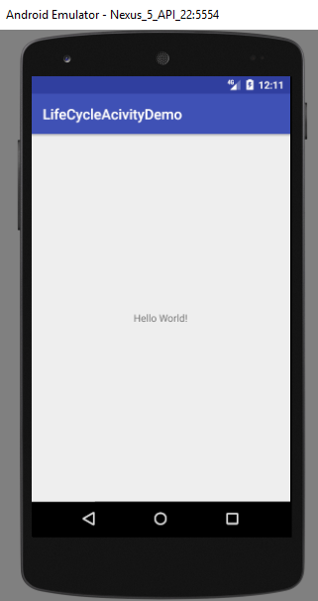
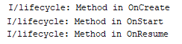
Activity Life Cycle – Screen Shots
Lifetime of an Activity is from onCreate() to onDestroy()
Activity is Visible when onStart() to onStop()
Activity is in Foreground onResume to onPause()
Screen 1 : After running the App, you will get the below screen and the Log message. The Activity is started by invoking 1. onCreate(), 2. onStart() and 3. onResume(). It is visible in the foreground.

Slide 51

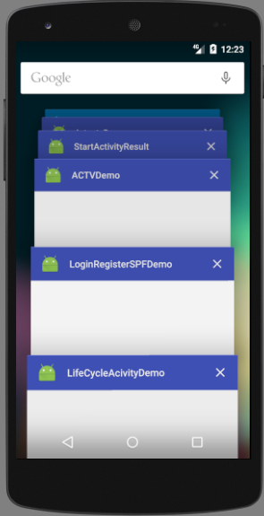
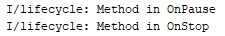
Activity Life Cycle – Screen Shots
Screen 2 : Now press the highlighted Pass button from your Emulator. The Activity is paused by invoking 1. OnPause() and 2. onStop().
Now it is not visible and not destroyed.

Slide 52
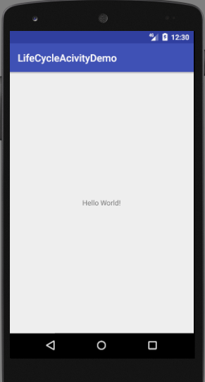
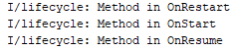
Activity Life Cycle – Screen Shots
Screen 3 : Again start your application by clicking highlighted start
button the from your Emulator and reload the same app. Now the Activity is restarted by invoking 1. OnRestart() 2. onStart() and 3. OnResume() itself. Now it is visible and not destroyed.

Slide 53
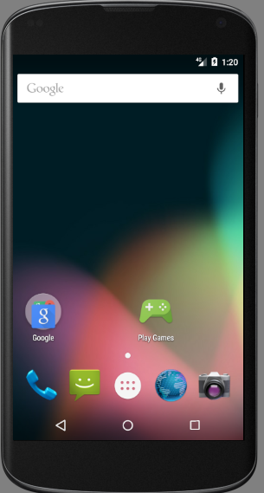
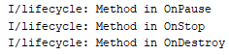
Activity Life Cycle – Screen Shots
Screen 4 : If you press the highlighted back button from your Emulator your activity is destroyed by invoking 1. onPause() 2. OnStop() and 3. onDestroy(). The lifetime of the activity becomes over.
Refer : Lesson4/LifeCycleActivityDemo (Demo with single activity)
Refer : Lesson4/ActivityLifeCycleAPP (Demo with two activitities)

Slide 54
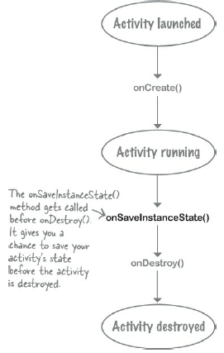
Saving instance state
The better way of dealing with configuration changes (Rotate Device, changing the language settings) which you’ll use most often is to save the current state of the activity, and then reinstate it in the onCreate() method of the activity.
To save the current state of the activity, you need to implement the onSaveInstanceState() method.
The onSaveInstanceState() method gets called before the activity gets destroyed, which means you get an opportunity to save any values you want to retain before they get lost.
The onSaveInstanceState() method takes one parameter, a Bundle. A Bundle allows you to gather different types of data into a single object
The Bundle class provides a container for storing data using a key-value pair mechanism. The keys take the form of string values, while the values associated with those keys can be in the form of a primitive value or any object

Slide 55
onSaveInstanceState(Bundle state)
// To save the current state of the activity, you need to implement the onSaveInstanceState() //method.
override fun onSaveInstanceState(outState: Bundle){
super.onSaveInstanceState(outState)
outState.putInt("count", mCount)
}
Refer : Lesson4\SaveStateDemo
To know more about Save State Information refer : https://developer.android.com/topic/libraries/architecture/saving-states

Slide 56
Restoring instance state
Two ways to retrieve the saved Bundle
in onCreate(Bundle mySavedState) Preferred, to ensure that your user interface, including any saved state, is back up and running as quickly as possible
Implement callback (called after onStart()) onRestoreInstanceState(Bundle mySavedState)

Slide 57
Restoring in onCreate()
override fun onCreate(savedInstanceState: Bundle?) {
super.onCreate(savedInstanceState)
setContentView(R.layout.activity_main)
mTextViewCount = findViewById(R.id.text_view_count)
if (savedInstanceState != null) {
mCount = savedInstanceState.getInt("count")
mTextViewCount?.text = mCount.toString()
}
}

Slide 58
Keyboard Shortcuts
Android Studio includes keyboard shortcuts for many common actions.
Refer : https://developer.android.com/studio/intro/keyboard-shortcuts

Slide 59
Main Point 3
During an Activity's runtime Lifecycle, an activity passes up and down through different states including onCreate(), onStart(), onResume(), onPause(), onStop(), onRestart(), and onDestroy(). Science of Consciousness: Similarly there are seven levels of consciousness, in the first three states waking consciousness; deep sleep and the dreaming state of sleep are known to every human being with a functional nervous system. The last four levels of consciousness; transcendental cosmic, god and unity consciousness are usually not available right away. These states become accessible only as one engages in regular practice of meditation.

Slide 60
Summary
The saving and restoration of dynamic state in an Android application is simply a matter of implementing the appropriate code in the appropriate lifecycle methods. For most user interface views, this is handled automatically by the Activity super class.
In other instances, this typically consists of extracting values and settings within the onSaveInstanceState() method and saving the data as key-value pairs within the Bundle object passed through to the activity by the runtime system.
State can be restored in either the onCreate() or the onRestoreInstanceState() methods of the activity by extracting values from the Bundle object and updating the activity based on the stored values.

